Slide 1
Lightning Robot
Abhash Ghimire

Slide 2
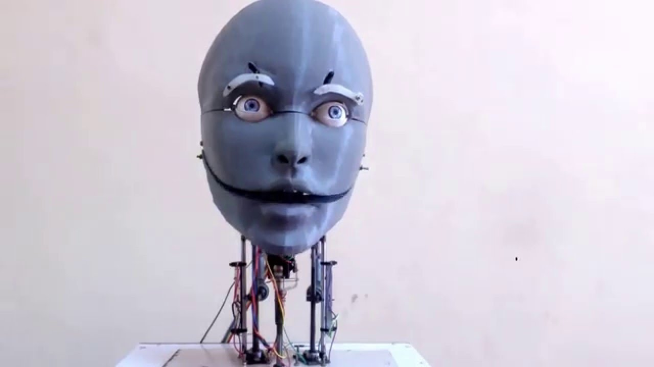
Head

Slide 3
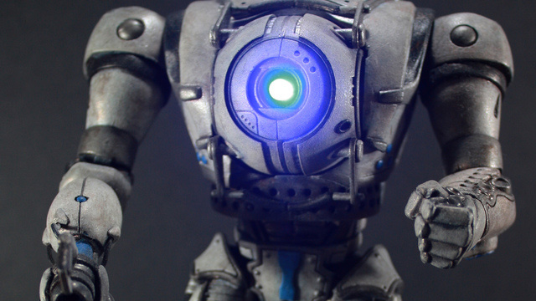
Body

Slide 4
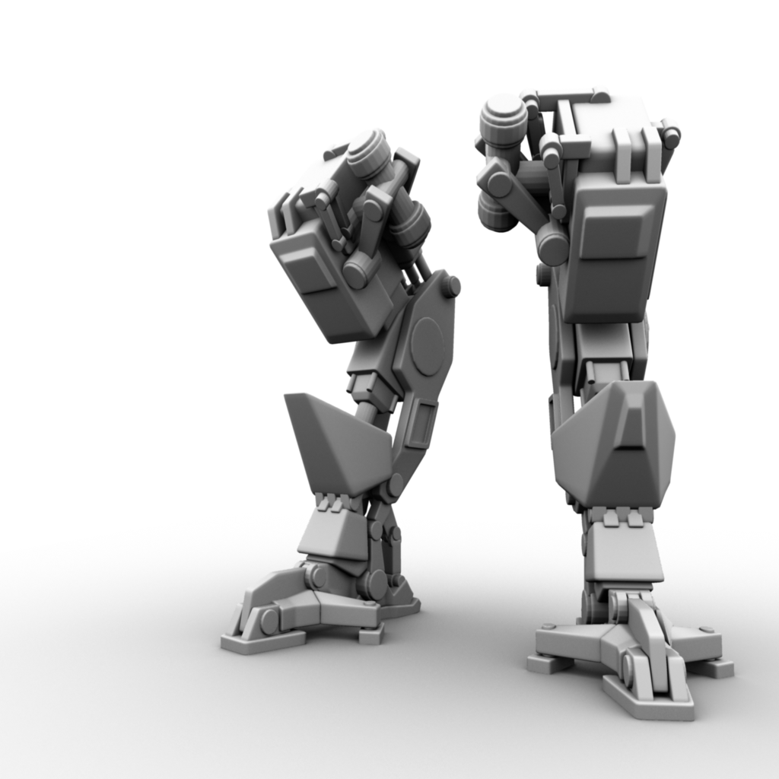
Leg

Slide 5
Work cited
https://www.kotaku.com.au/2012/08/giving-portals-wheatley-a-giant-robot-body/
https://www.pinterest.com/masterxeon1001/robot-legs/

